Slide 1




TVShows Project
By: Raihan Patel

Slide 2

Contents
Specification
Planning
Technologies Used
Project Demo
Summary

Slide 3
Specification
Create a CRUD Application
Incorporate All Elements of Training

Slide 4

My Design

Slide 5
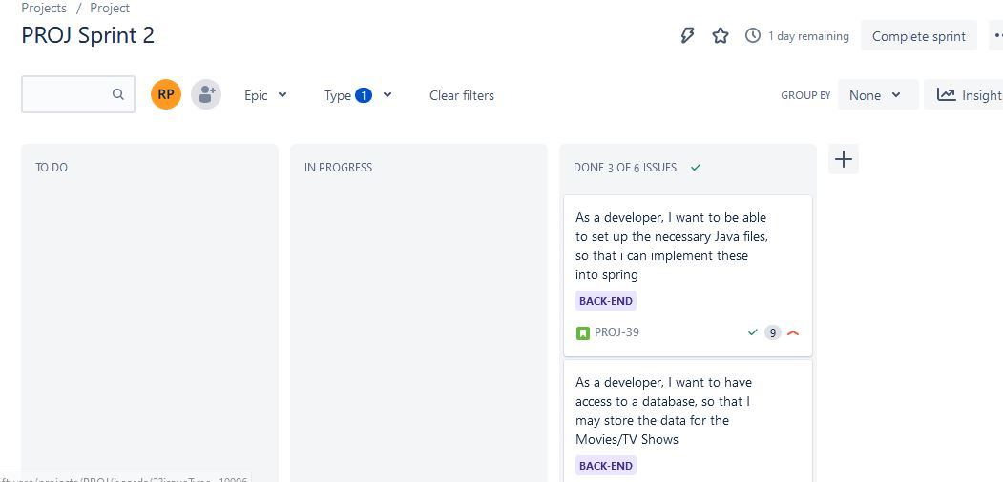
Planning
Jira
Plan for
Software Coding

Slide 6

Technologies
Version Control
Database
Back-End
Front-End

Slide 7
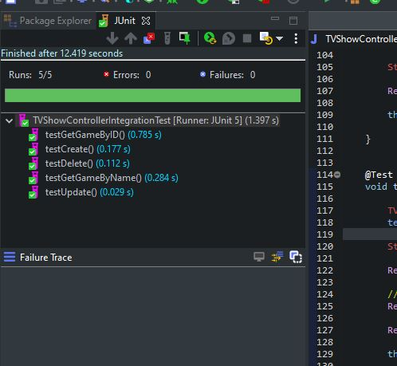
Testing
Unit
Integration
h2 database

Slide 8
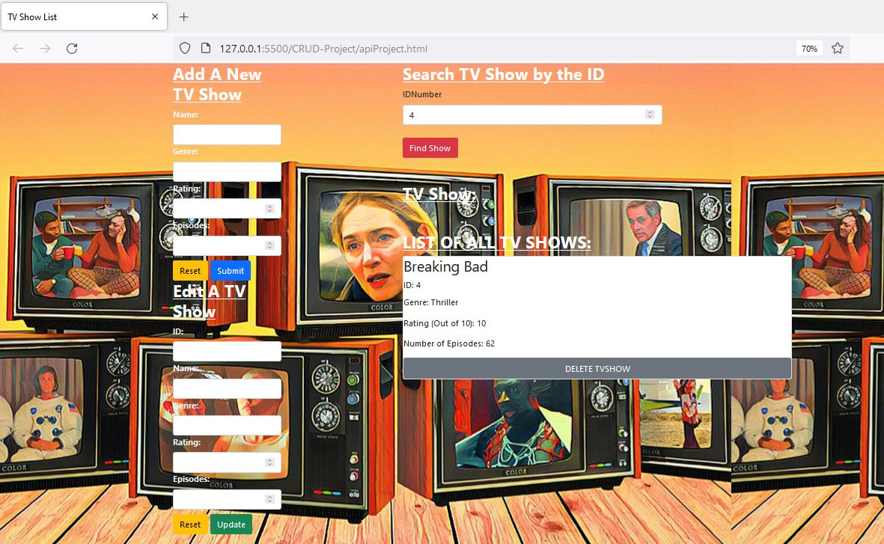
Result of Project

Slide 9

Self Reflection
Positives
Negatives
Lesson Learnt
What I would do differently

Slide 10
Further Development
Another table
Implement a sort by section
Link to another webpage
Another styling tool

Slide 11
Thank You
Any questions?

